Slide 1
Treatment of war veternas suffer from PTSD – Croatian experiences
Prof. Dolores Britvić, University Hospital Split, School of Medicine Split, Croatia

Slide 2
PSYCHOLOGICAL TRAUMA
  The state in which a person who has experienced a difficult event is in, which threatens his life safety

Slide 3


Traumatic event

Slide 4
Traumatic event :
unpredictable
out of control
destroys the sense of security
makes us sensitive and anxious
most of those exposed recover within a few months

Slide 5

Traumatic event :
Context Person
Traumatic - Meaning - Consequences
event
Social support

Slide 6
Differences between trauma and stress
SITUATION
Trauma is a sudden, dramatic event, that changes the way we perceive the world. A momentary event is often life-threatening.
Stress is a reaction to less dramatic and often everyday events that are perceived as threatening.

Slide 7
A FEELING OF CONTROL
the feeling of loss of control, and repeated recollections of the event, prevents them from engaging in everyday life.
people who experience stress maintain a sense of control, they may be irritable or worried, but they manage to function
BREAK, REST
in the case of stress, it brings relief, while in the case of psycho-trauma, it is not possible to achieve it.

Slide 8
Diagnosis of PTSD
TRAUMATIC EXPERIENCE
psychological trauma occurs when someone is exposed to death or the threat of death, as well as after direct exposure or witnessing trauma or learning that a relative or close friend has been exposed to trauma, or direct exposure to aversive details of violent or accidental traumatic events (APA, 2013.).

Slide 9
PTSD SYMPTOMS
FLASHBACKS AND DISTURBING DREAMS
INCREASED AROUSAL
- anxiety and panic attacks
- restlessness
- impaired concentration
- irritability
- insomnia

Slide 10
PTSD SYMPTOMS
AVOIDANCE OF REMINDERS OF THE STRESSFUL EVENTS
EMOTIONAL NUMBNESS
DIFFICULTY IN RECALL OF THE STRESSFUL EVENTS
DEPRESONALIZATION AND DEREALIZATION

Slide 11
PTSD SYMPTOMS
SOMATIC SYMPTOMS
palpitation, sweating, tremor
DEPRESSIVE SYMPTOMS
MALADAPTIVE COPING RESPONSE-
anger, often believe they are innocent victims of others,
excessive use of alcohol or drugs
episode of deliberate self harm, suicide

Slide 12
Complex PTSD
PTSD Symptoms + personality changes
- problems in interpersonal relationship
- affective dysregulation
- negative cognition

Slide 13
Personal factors associated with developing PTSD
Age: adolescent and old people,
Family psychiatric disorder
Childhood abuse
Early life trauma
Low intelligence
Previous psychiatric history
Low self-esteem

Slide 14
Factors from the traumatic event
Traumatic events can occur at different stages of life.
As a rule, their impact is stronger and more devastating if the traumatic event occurred early in a person’s life.
The nature and duration of the traumatic event may also play a role in how one will respond to the traumatic event.
Traumatic events marked by interpersonal violence have a stronger impact than natural disasters.

Slide 15
Social factors
Community-based social support plays an important role in how an individual will cope with a potentially traumatic experience.
Stories, legends, religion, myths and rituals that are part of the specific culture are important mechanisms, by which an individual may help in coping with grief and loss.
Mourning rituals allow the bereaved person to control his/her emotions and behaviour, belonging to social group as a symbol of continuity.
Family and workplace support are often critical factors in building adaptive capacities in response to trauma.

Slide 16
Drastic changes in the system of social values, personal expectations and value systems.
War is causing the breakdown of the traditional system, leading to the loss of community’s cultural identity, whose place is mostly taken by negative identity models and different ways of creating social groups.
When the protection and safety of one community’s culture fall short, paranoia becomes a substitute for trust, aggression takes the place of care and support, identity confusion or negative identity becomes asubstitute for the positive identity.

Slide 17

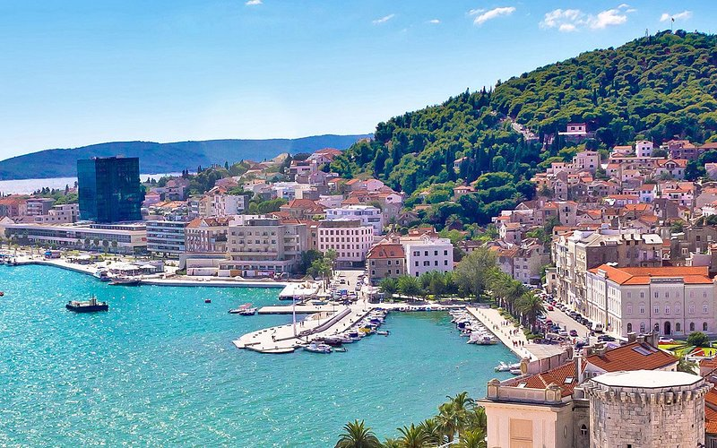




Slide 18
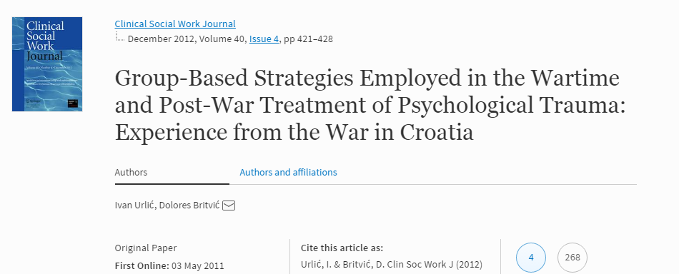

Slide 19
The First Phase
The organization of the psychological and psychosocial treatment of displaced persons
Second Phase
The second phase in helping people suffering from psychological trauma, both during and after the war, consisted of psychodynamically oriented psychological treatments, psychosocial interventions and support.
We prepared refugees and DCs for their return to their homes in the liberated territories. Our professional attention was especially directed toward patients with complex PTSD

Slide 20
The Third Phase
Regional psychotrauma centers are responsible for the organization of psychological treatment and psychosocial help to war veterans and persons seeking assistance with a family member (usually a father/husband) suffering from PTSD and stress-induced personality disorders.

Slide 21
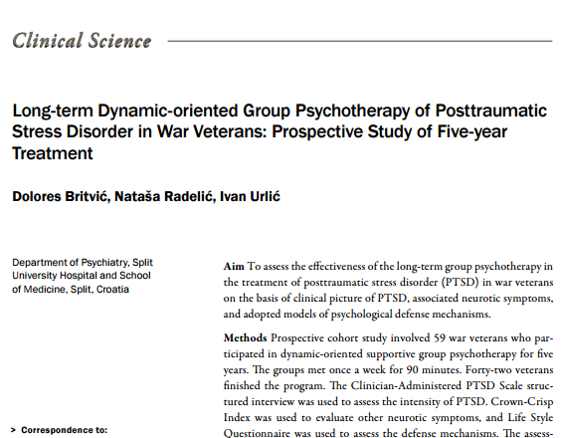

Slide 22
The purpose of this study was to assess the effectiveness of group psychotherapy in war veterans with PTSD by evaluation of clinical picture of PTSD, associated neurotic symptoms, and adopted models of psychological defense mechanisms.

Slide 23
Symptoms of PTSD
The symptoms of reenactment of traumatic experience were least prominent at the end of treatment.
Symptoms of avoidance and emotional numbing, six out of seven symptoms were not significantly different at the beginning, after two, and after five years of psychotherapy.
The intensity of some symptoms increased excitation, was significantly reduced at the end of treatment.

Slide 24
Defense Mechanisms
At the very beginning of the psychotherapeutic treatment, projection and displacement were predominant defense mechanisms.
After the long term group psychotherapy there were no major changes in the model of defense mechanisms used.

Slide 25
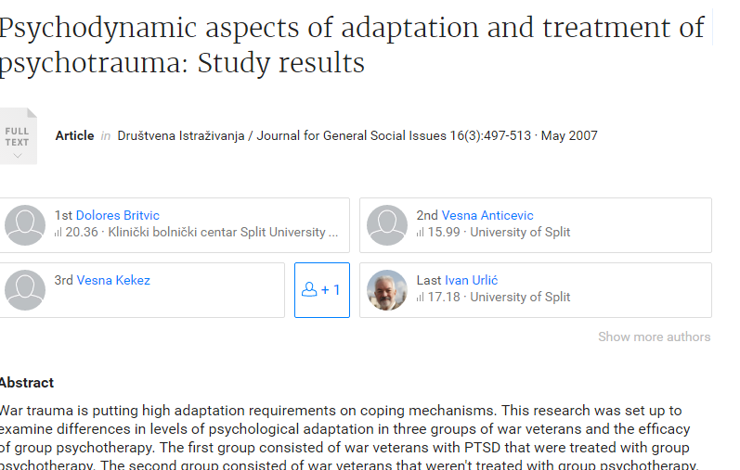

Slide 26
This research was set up to examine differences in levels of psychological adaptation in three groups of war veterans and the efficacy of group psychotherapy.
1st group consisted of war veterans with PTSD that were treated with group psychotherapy.
2nd group consisted of war veterans that weren't treated with group psychotherapy.
3th group consisted of war veterans that were not diagnosed as suffering from PTSD.
The research tools applied were: CAPS, Crown-Crisp Experiential Index, and Life-Style Questionnaire.

Slide 27
The obtained results demonstrated that the first group showed significantly less pronounced symptoms of PTSD than group two.
Depression was found expressed in all three groups.
Projection was found to be the dominant defense mechanism in all groups.
The mechanism of regression was found to be significantly more frequent in the group treated with group psychotherapy.

Slide 28
The exposure to war trauma might favor the development of depression and the use of immature mechanisms of defense even when the clinical picture of PTSD is not developed.

Slide 29
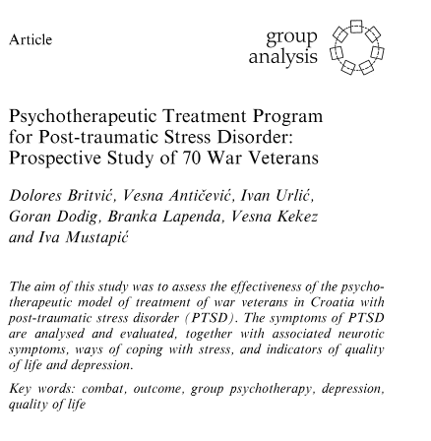

Slide 30
Therapeuthic technique:
Aiming towards these goals in tretment of PTSD, we
implemented a psychoterapeuthic programme that lasted 40
weeks.
The psychotherapeutic programme consisted of three
different group modalities:
1. Socio-therapeutic group
2. Psycho-educative group
3. Trauma - focused group.
Each group consisted of 8-11 patients.
Each session lasted 60 min. conducted by one therapist.

Slide 31
Results:
Increase in problem-focused strategies and
avoidant strategies in coping with stress
Reduction of depression

Slide 32
The Poetry of war veteran
You do not understand my fears
In the nights that torment me.
My partner and his sister horror
They crawl all over my body at night
And they say:
"Wake up tonight there is no peace for you!"
(“Nothing hurts me,” V. J.)

Slide 33
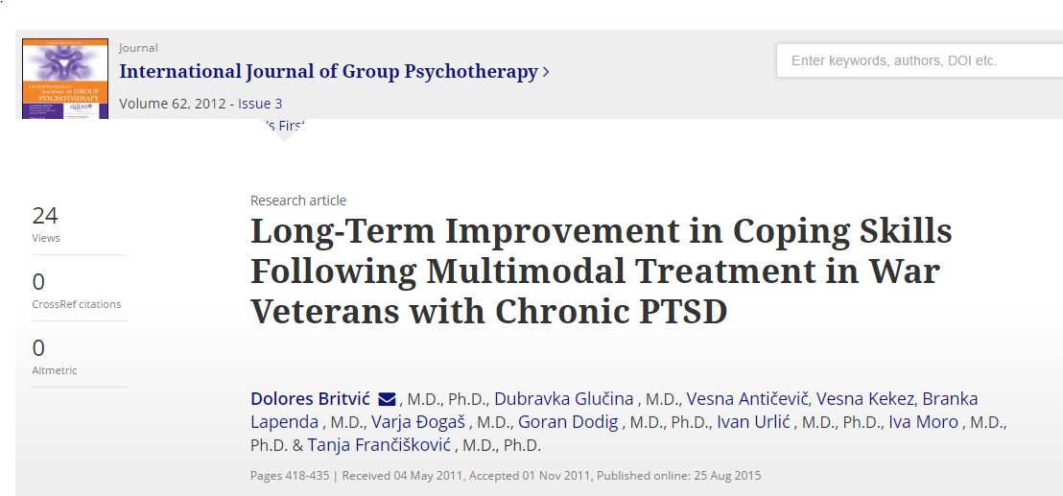

Slide 34
Results
The findings revealed short-term reduction in the symptoms of PTSD and depression, while the long-term results were manifested as the increased use of all coping mechanisms and a greater level of obsession.

Slide 35
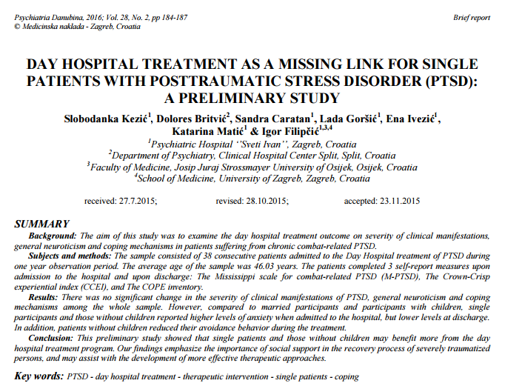

Slide 36
Our findings emphasize the importance of social support in the recovery process of severely traumatized persons, and may assist with the development of more effective therapeutic approaches.

Slide 37
Predictors of positive results of treatment are: - older age, employement, less number of hospitalization and histerical personality traits, absence of complex PTSD.

Slide 38
Munjiza et all., BMC Psychiatry, 2019.
Lasting personality pathology following exposure to severe trauma in adulthood: retrospective cohort study
Jasna Munjiza, Dolores Britvic and Mike J. Crawford

Slide 39
Results
Participants with late-onset personality pathology were three times more likely to have complex personality pathology across all three DSM-IV clusters compared to those with PD (OR = 2.96, 95% CI 1.54 to 5.67) after adjusted for gender and marital status.
The prevalence of depression and social dysfunction were as high among those with late-onset personality pathology as among those with personality disorder.

Slide 40

Thank you!

