Slide 1
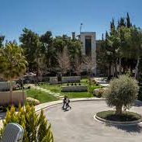
Princess Sumaya University for Technology Amman, Jordan
prof. dr. sc. Renata Relja
v. pred. dr. sc. Helena Burić
27.5.- 4.6. 2023.

Slide 2
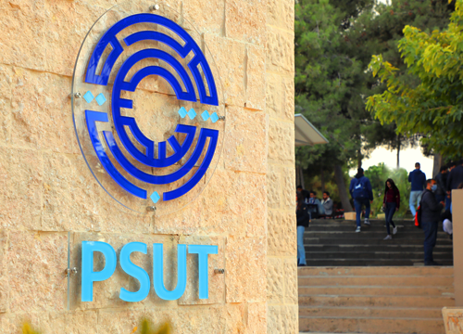
Ustroj institucije
King Abdullah I School of Graduate Studies & Scientific Research
King Abdullah II School of Engineering
King Hussein School for Computing Sciences
King Talal School of Business Technology
Royal Scientific Society

Slide 3
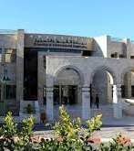
Staff Week May 29 – June 02, 2023.
Staff week uključio je niz aktivnosti :
Welcome note: by PSUT president Professor Wejdan Abu Elhaija;
PSUT international involvement Director of International Relation, Dr. Radhi Hamadeen;
PSUT mobility programs and summer schools ICM and Study abroad Coordinator, Professor Omar Bani Ahmad
Partner presentations
Tour PSUT
Requested one‐to‐one meetings with PSUT staff Lecture delivery for Teaching staff
Social Dinner

Slide 4
Staff Staff Week May 29 – June 02, 2023.
Tijekom kontakata s kolegama sa Sveučilišta kao i ostalih sudionika
razmotrene su mogućnosti buduće suradnje u sklopu znanstvenih i istraživačkih projekata.
Bila je riječ o nastavka suradnje u sklopu ERASMUS+ programa i mobilnosti studenata kao i nastavnoga i nenastavnoga osoblja.

Slide 5
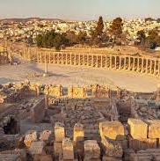
Ostale aktivnosti u sklopu Staff week programa
Organizatori su sudionicima organizirali i posjet Roman city of Jerash , izlet u Petru i pustinju Wadi Rum

Slide 6
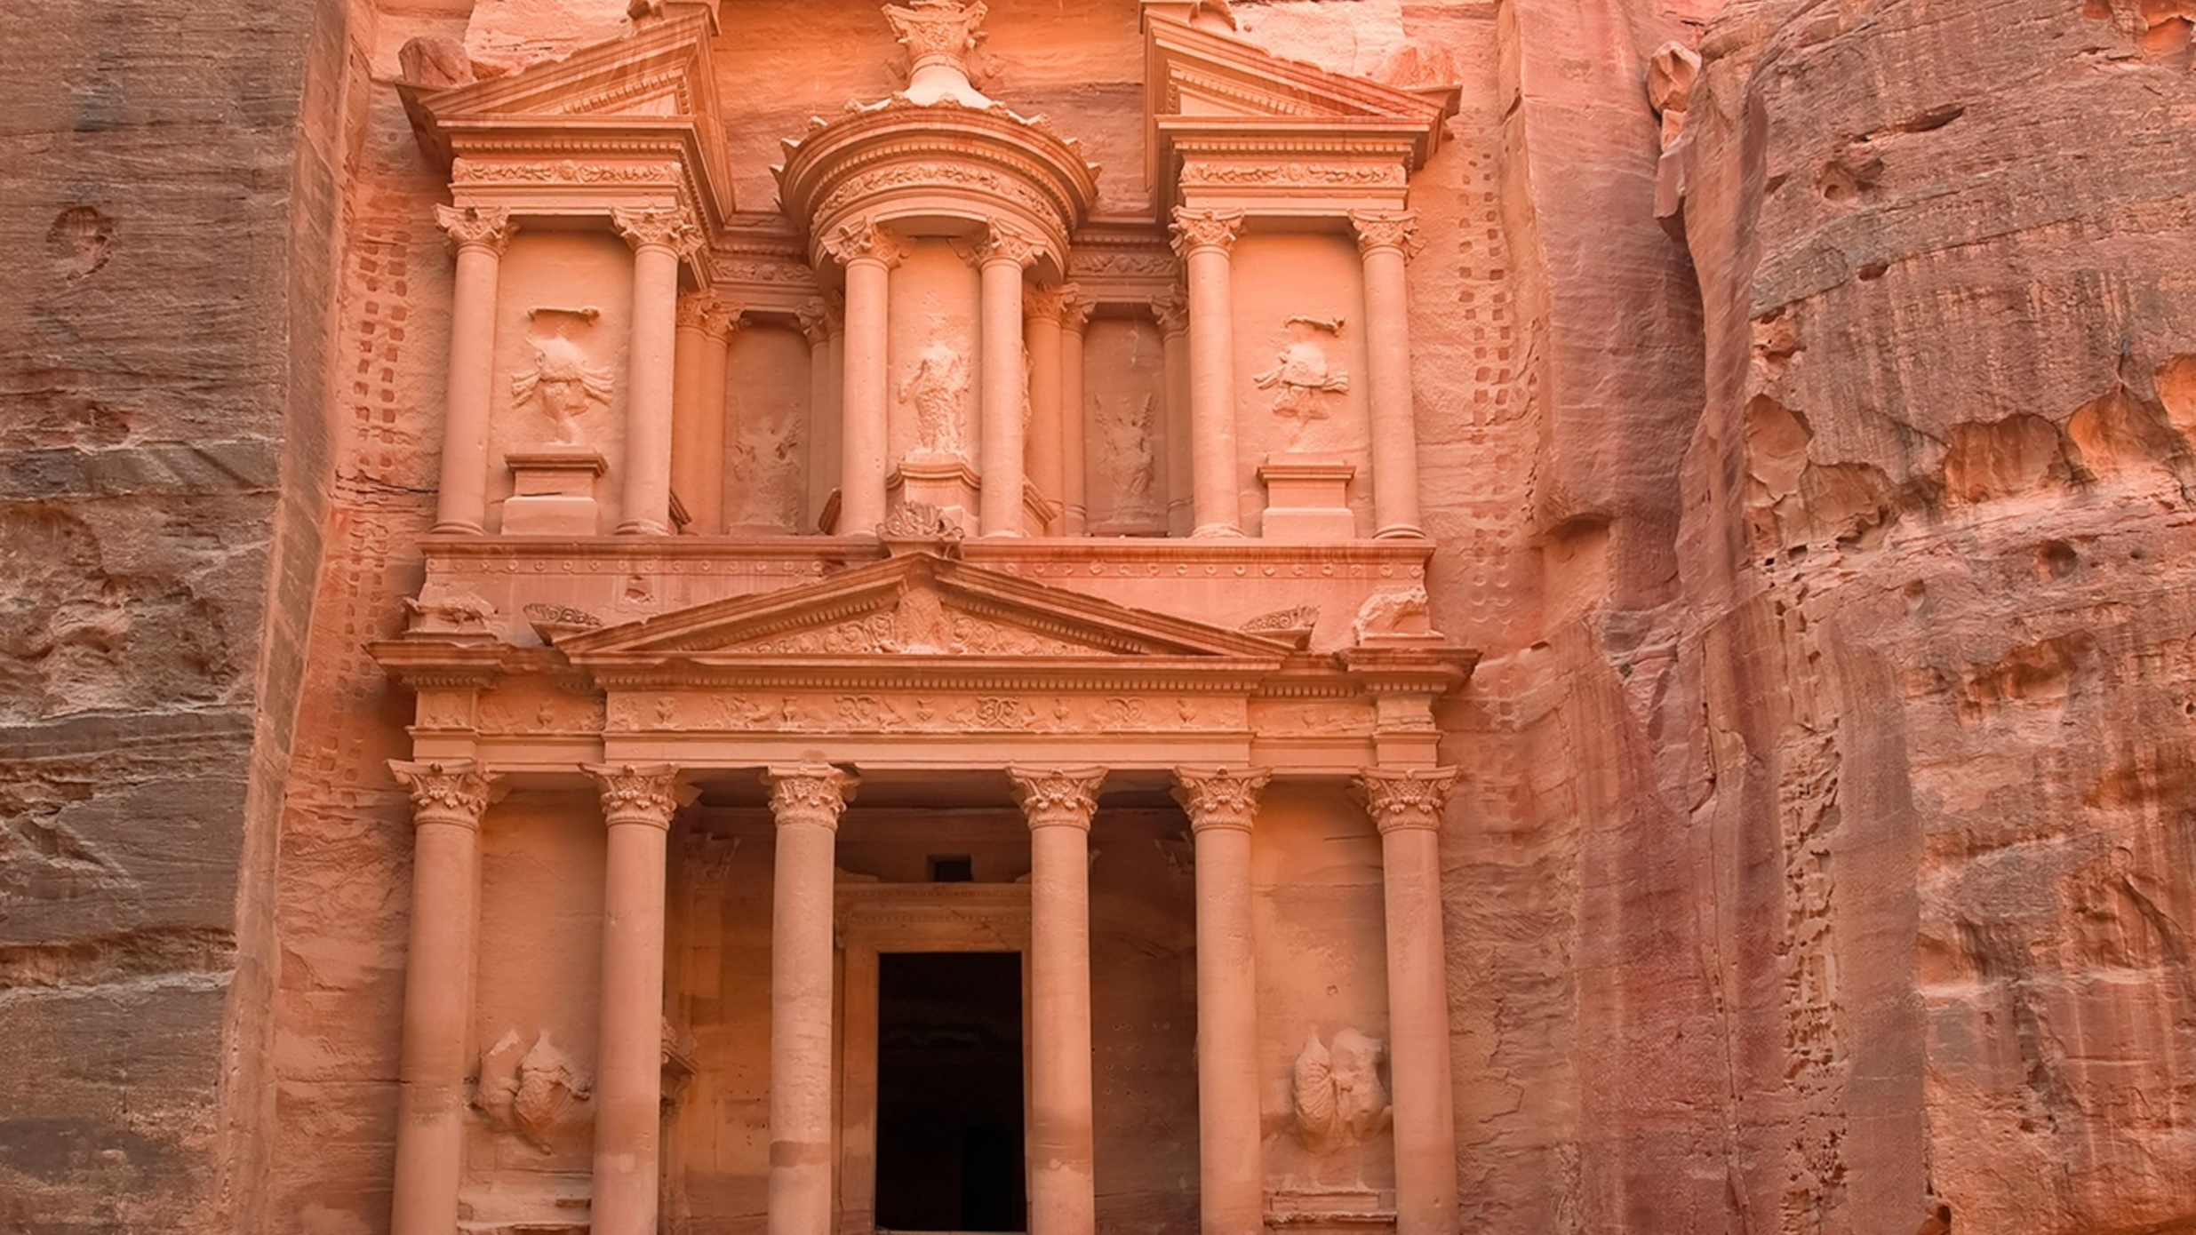

Slide 7


